Slide 1
Automatic locator change detection and prediction on web page in Software Testing
Presented By:
Ajita Patel
R18MBA51

Slide 2

Agenda
Business Understanding
Data Understanding
Data Preparation
Modeling
Evaluation
Deployment

Slide 3
Problem Statement
Reduce the manual intervention in automation test failure for any locator changes

Slide 4

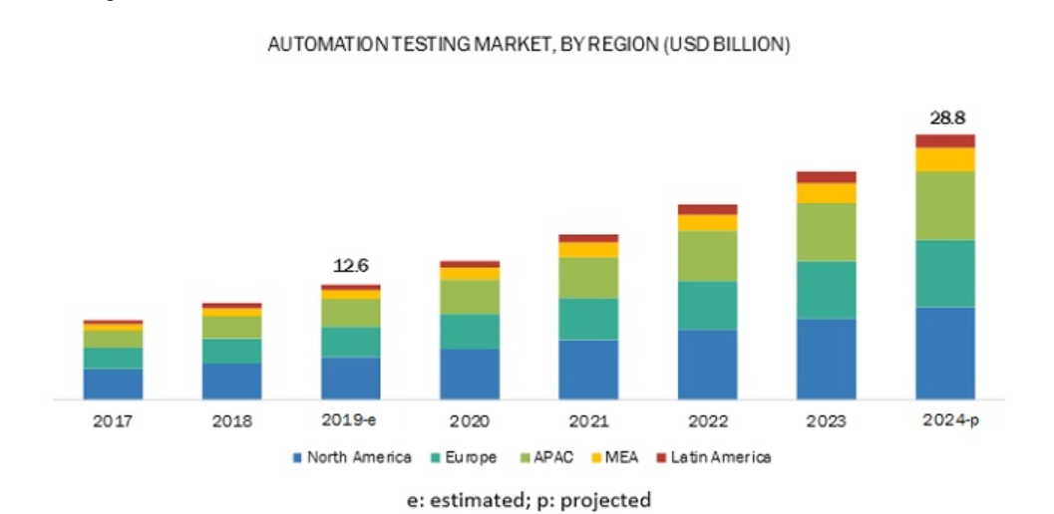

Business Understanding
As per the survey, average cost of an automation engineer per hour is $45.
One Engineer spends ~4 hours per week in analyzing the failure
100 engineers
1600 hours per month
$72000 per month
$864000 per year
Ref link- https://www.marketsandmarkets.com/Market-Reports/automation-testing-market-113583451.html

Slide 5
Challenges in GUI automation
Control names are dynamically changing
Class name dynamically changing
Application window is dynamically changing
Controls which don’t have proper and unique text property
Application developed in multiple languages

Slide 6
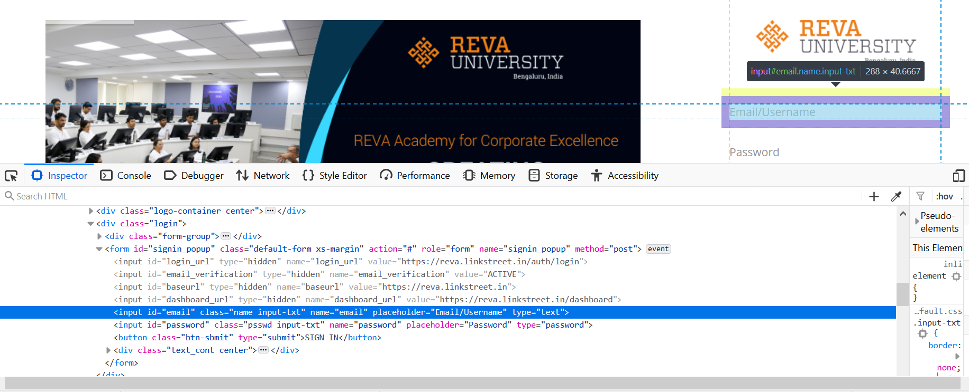
What is X-path?
Automation testing perspective
x-path helps in identifying the web elements
<input id="email" class="name input-txt" name="email" placeholder="Email/Username" type="text">']
Xpath of the Username
Eg: //input[@id='email']

Slide 7
Approach
Build
Preprocessing
Inference Engine
Identify Locator Changes
Validate
Generate List of Changed Locator
Feature Extraction
Classified Data
UI Change
X-path
Predict
YES
Post Processor
NO
Pass
Pass

Slide 8

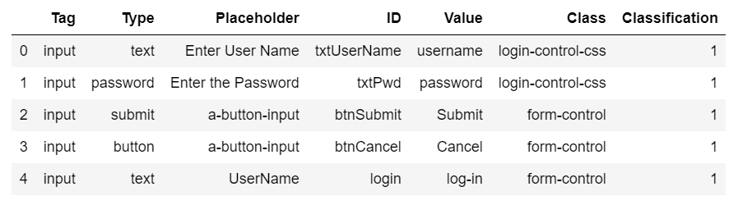
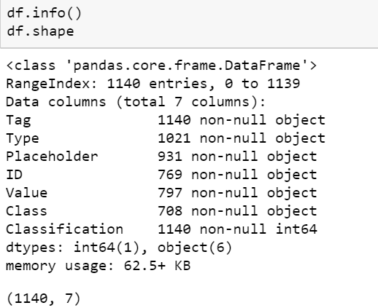
Data Understanding
Tag Returns the tag name of an element
Type value of the node name
Placeholder The placeholder attribute specifies a short hint
that describes the expected value
ID String, representing the ID of an element
Value Specifies the node value of the specified node
Class Specifies the class name of an element.

Slide 9
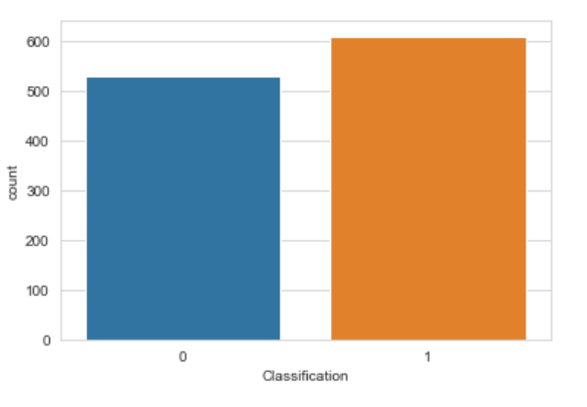
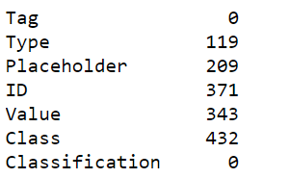
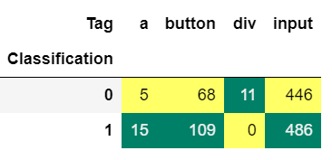
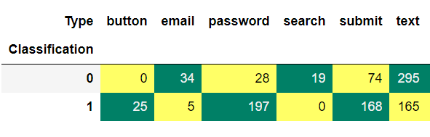
Data Understanding
Distribution 0/1
Missing Values

Slide 10

Data Preparation
Collect data from different websites
Convert the data into rectangular form
Feature Engineering
70 / 30 Training and Testing

Slide 11

Modeling
Naive Bayes
Logistic Regression
Random Forest
K-Nearest Neighbor
XG Boost

Slide 12
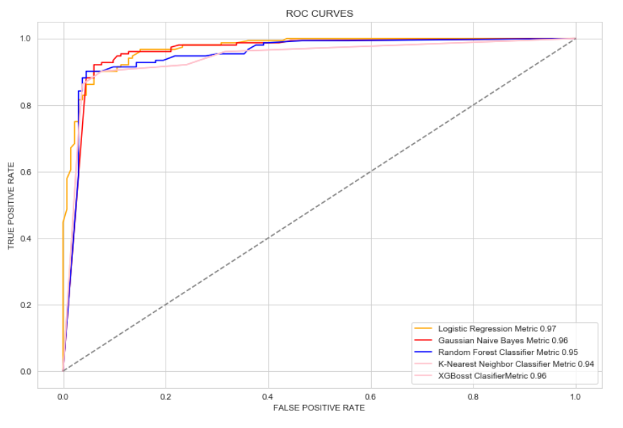
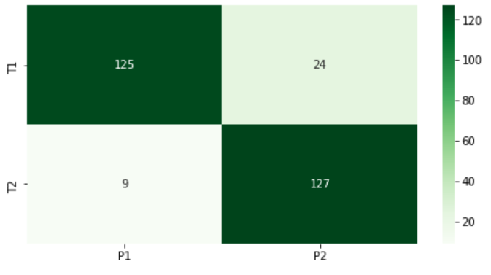
Evaluation

Slide 13
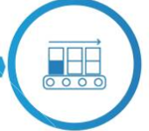
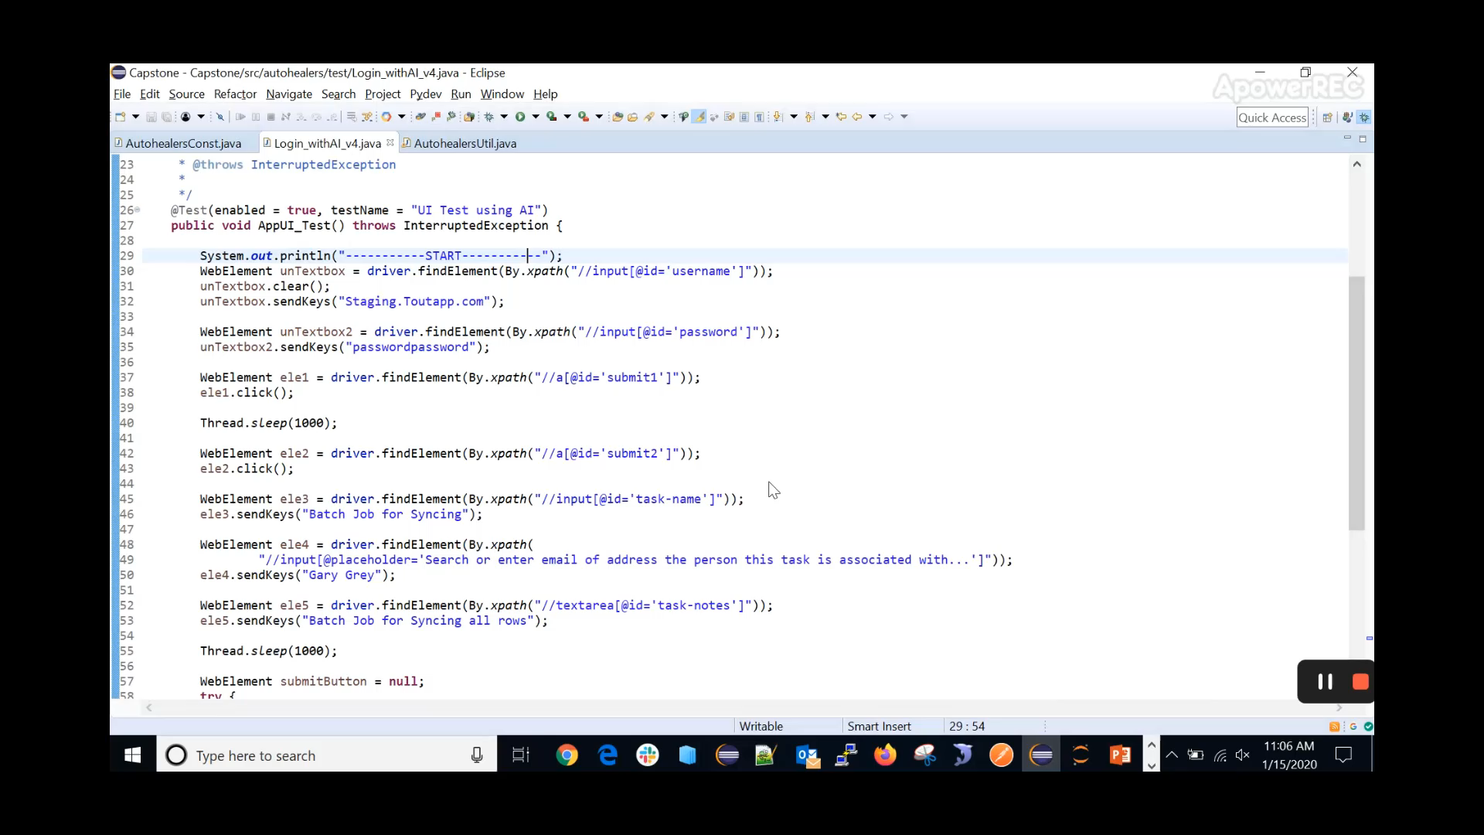
Deployment

Slide 14
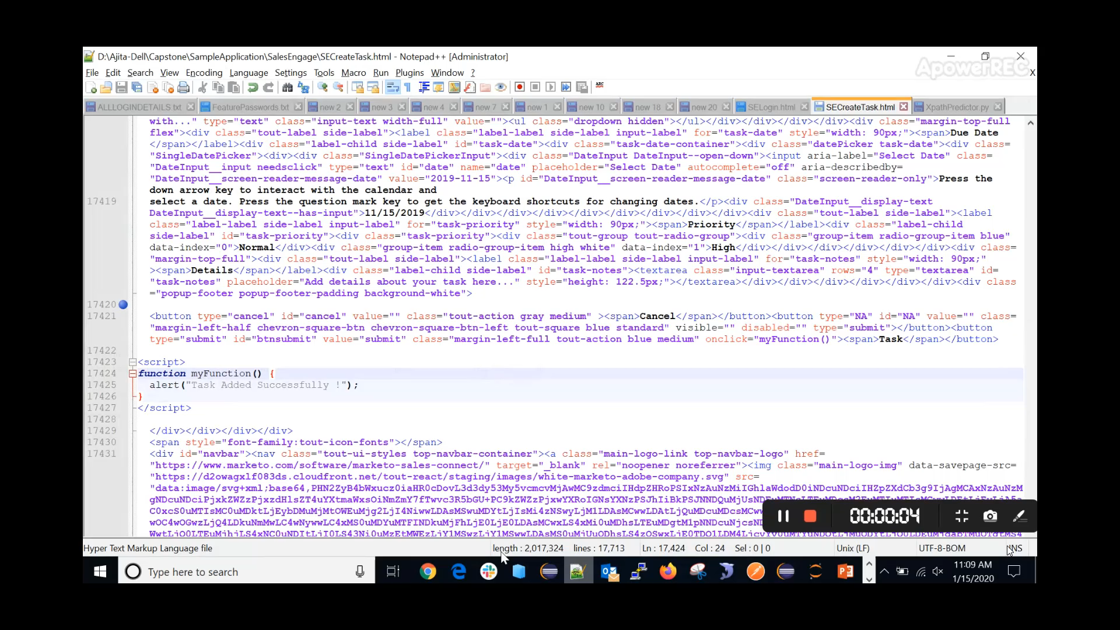
Deployment

Slide 15
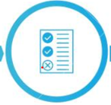

BusiConclusion
Reduction in test maintenance efforts. Since it reduces the number of failures, the maintenance also is reduced.
Failure only on functional issues.
Faster time to market. Reduced the number of failure cases 10%

Slide 16
Future Enhancement
Add-on file for larger scale Test automation
Plug & play jar file

Slide 17
Thank You

